Slide 1
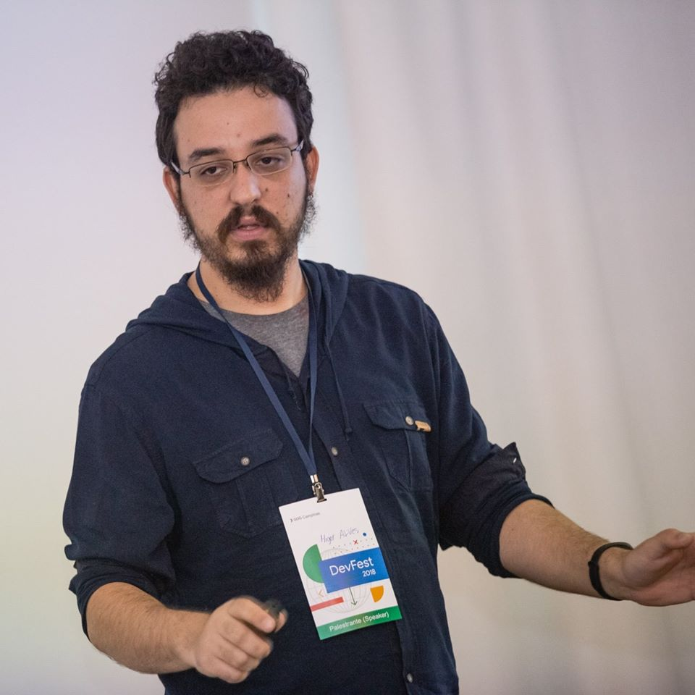


Higor Alves
Software Developer & Consultant
higoralves
higorhaalves

Slide 2





StudioMVP
React Brasil
NodeJS Brasil
Brazil JS
Things Hacker Team

Slide 3


Slide 4


Slide 5
Const – let – var

Slide 6
Funções

Slide 7
Operadores Logicos

Slide 8
Condição ternaria

Slide 9
Arrow Functions

Slide 10
Destructing

Slide 11
Operadores Rest/Spread

Slide 12
Promises

Slide 13
Async Await

